Slide 1

Reclaimer: A Reinforcement Learning Approach to Dynamic Resource Allocation for Cloud Microservices
Based on research published in IEEE Access, 2022
Presented by: Krish Kapadia/Namit Kale/Yuvraj Patil/Atharva Karpe

Slide 2
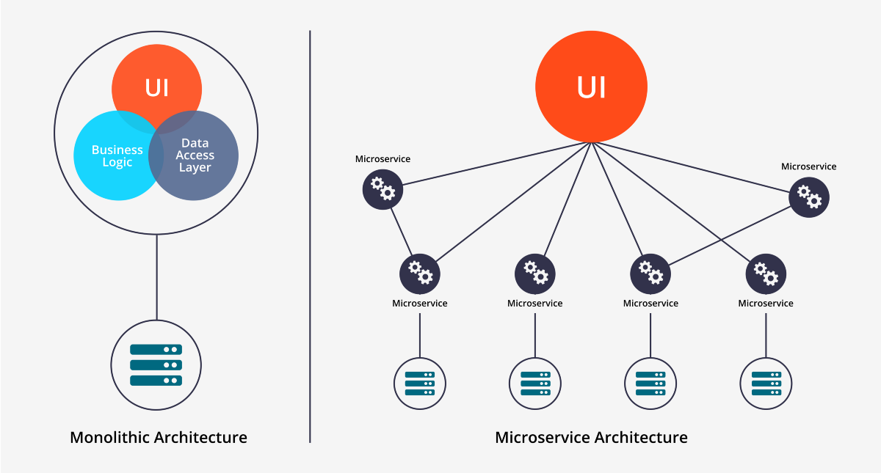
Microservices Architecture
Definition:
Loosely coupled, independently deployable services (e.g., Netflix's recommendation engine)
Communicate via APIs (REST/gRPC)
Benefits:
Scalability: Scale individual components (e.g., only "payment service" during peak loads)
Fault Isolation: Crash in one service ≠ entire app failure

Slide 3
Key Challenges
Dynamic Workloads
Real-world examples of traffic spikes:
Flash sales events (e.g., Black Friday)
Social media trending content
Breaking news events
Product launches
Scheduled events (sports, concerts)
Resource demand fluctuations:
Daily patterns (business hours vs. overnight)
Weekly patterns (weekday vs. weekend usage)
Seasonal patterns (holiday shopping, tax season)
Geographic patterns (time zone differences)
Technical consequences of under-provisioning:
Request queuing increases latency exponentially
Thread pools become saturated
Blocking calls create cascading failures
Timeout errors propagate through service dependencies
Database connections get exhausted

Slide 4
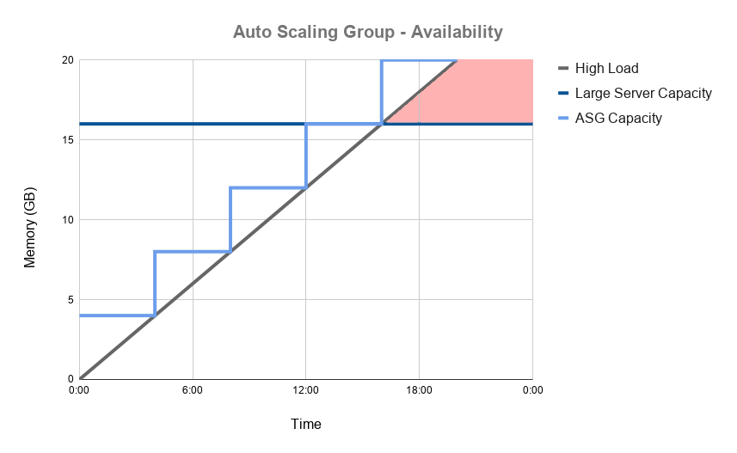
Limitations of Existing Solutions
Autoscale (Industry Standard):
Reactive: Scales after CPU hits 80% → violations occur first
Static thresholds → cannot adapt to dependencies
Sinan (SOTA ML Approach):
Requires per-application tuning → not generalizable
Uses hand-engineered policies → inflexible

Slide 5
Reclaimer's Innovation
Proactive Approach
Predictive capability details:
Uses current system metrics to anticipate future states
Learns temporal patterns in workload characteristics
Identifies early warning signals for potential QoS violations
Makes CPU allocation decisions 1-5 seconds before traditional thresholds would trigger
Considers both immediate state and recent history (stacked observations)
How RL enables proactivity:
Learns correlation between resource allocation and future latency
Maximizes long-term rewards rather than reacting to immediate metrics

Slide 6
Reclaimer's Architecture
Feature Extraction
Data collection mechanism:
Non-invasive monitoring through Docker's stats API (no code instrumentation required)
Leverages Linux cgroups interface for low-level resource metrics
Samples at 1-second intervals for real-time responsiveness
Collects 40+ distinct metrics per microservice
Key metrics gathered:
Latency distribution (P50, P90, P95, P99, P99.9, P99.999)
CPU utilization (user time, system time, throttled time)
Memory usage (RSS, cache, swap, page faults)
Network activity (packets sent/received, bytes in/out)
I/O operations (read/write operations, bytes, wait time)
Queue depth and request rates
Pre-processing pipeline:
Normalization of values across different scales
Windowed statistics (rolling averages, variances)
Feature stacking for temporal context (last k=5 timesteps)
Missing data handling with forward-fill imputation

Slide 7
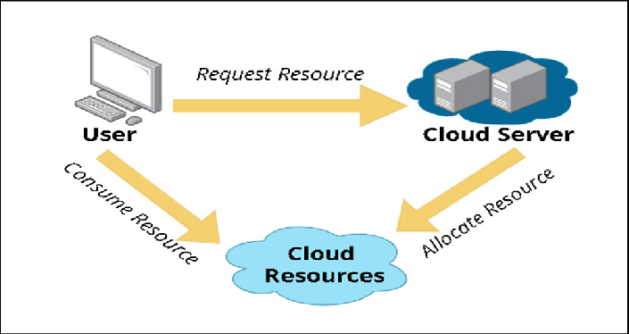
Reclaimer’s Architecture
RL Policy Implementation
SAC components in detail:
Actor network: Maps state to action distribution parameters (μ, σ)
Twin critics: Q1, Q2 networks to prevent overestimation bias
Value network: Estimates expected rewards for stability
Entropy regularization: Balanced exploration vs. exploitation
Neural network architecture:
Input layer: 40+ features × k timesteps
Hidden layers: 7 fully-connected layers (256 neurons each)
ReLU activations with batch normalization
Output layer: Action distribution parameters
Training frequency: Policy updates every 10 seconds
Action Enforcement
Technical implementation:
Docker API calls to update CPU quota in real-time
Precise floating-point CPU allocations (e.g., 0.25 cores)
Linux CFS (Completely Fair Scheduler) enforces allocations
Non-disruptive updates (no container restarts required)

Slide 8
Markov Decision Process
Temporal metrics collection:
Raw metrics sampled at 1Hz (every second)
Each state includes stacked observations from k=5 previous timesteps
Provides temporal context for detecting trends, not just instantaneous values
Total state dimension: ~200 features (40+ metrics × 5 timesteps)
Specific metrics breakdown:
Latency distributions: Full percentile spectrum (P50, P90, P95, P99, P99.9, P99.999)
CPU metrics: User time, system time, throttled time, runnable processes
Memory usage: RSS, cache usage, active/inactive memory, major/minor page faults
I/O statistics: Bytes read/written, operations, wait time, queue depth
Network activity: Packets in/out, bytes in/out, connection count, errors
Application metrics: Request rate, queue length, active connections
System-wide metrics: Total available CPU, memory pressure, container count

Slide 9
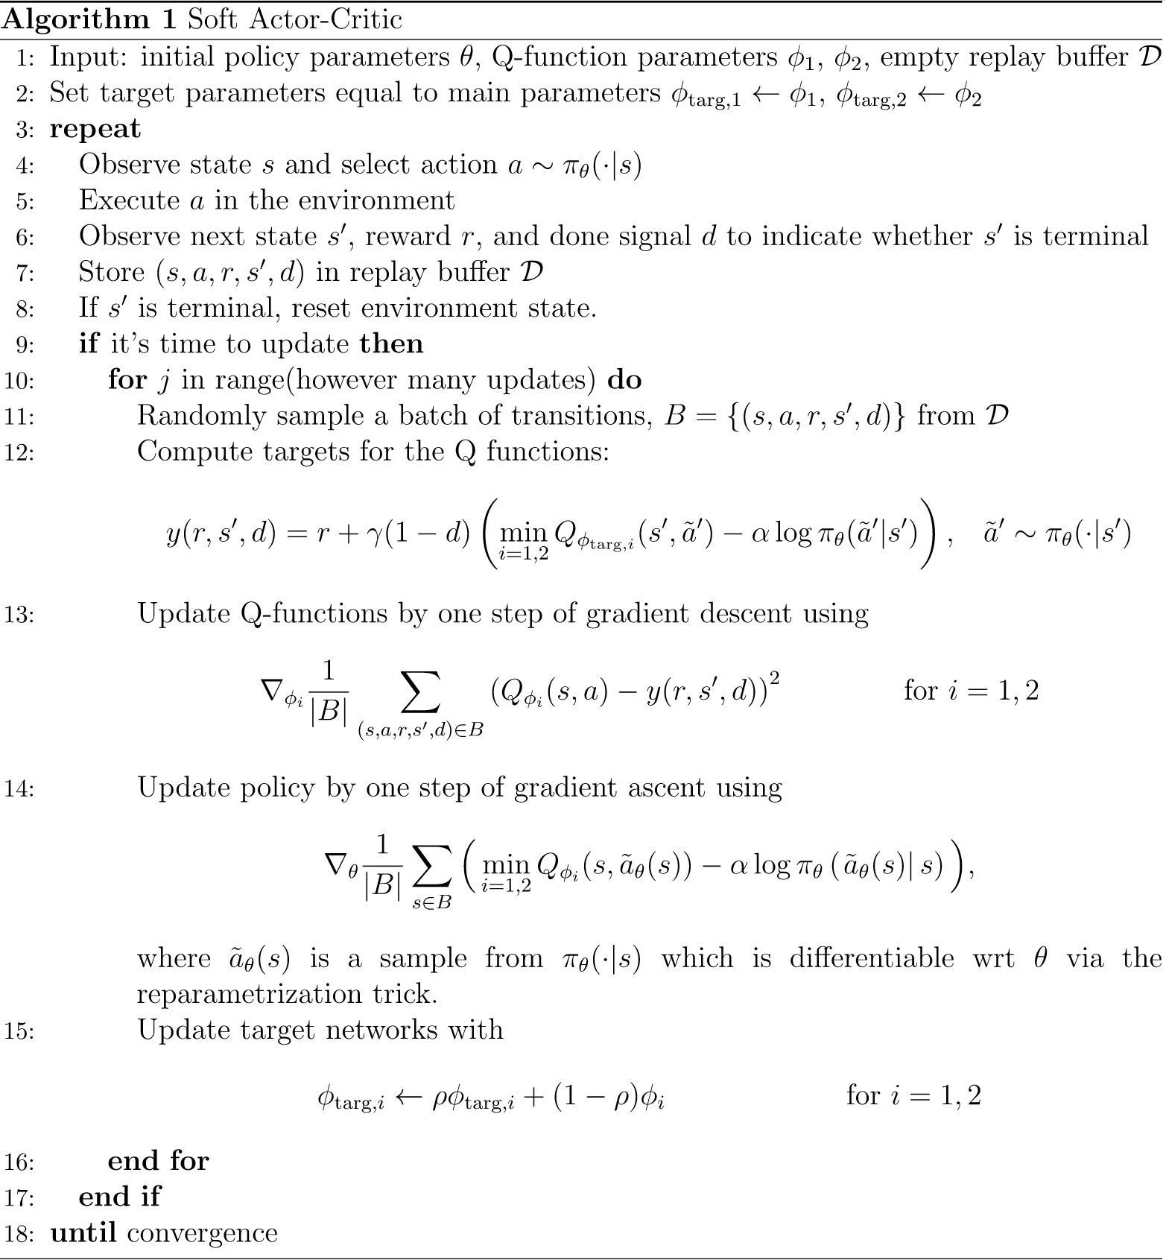
Soft Actor-Critic (SAC) Algorithm
Why SAC? - Additional Context
Sample efficiency advantages:
Learns effectively from limited data (crucial for production systems)
Experience replay buffer stores 100,000+ timesteps
Can extract multiple learning updates from each observation
Reduces training time by 60-70% compared to on-policy algorithms (e.g., PPO)
Stability features:
Automatic temperature parameter tuning balances exploration vs. exploitation
Less sensitive to hyperparameter choices than alternatives (DDPG, TD3)
Robust to noisy observations in production environments
Gradient clipping prevents catastrophic updates
Key Components - Technical Details
Policy Network specifics
Twin Q-Networks implementation:
Algorithm optimizations:

Slide 10
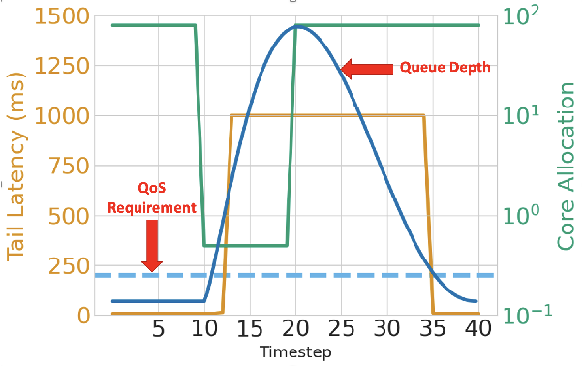
Policy Network Design
Layer-by-layer breakdown: Input layer: Dynamically sized to accommodate variable metrics (40+ × 5 timesteps)
Embedding layer: Projects variable inputs to fixed dimension (320 units)
Weight sharing mechanism: Base trunk: 6 shared layers process common features
Microservice-specific heads: Final layer adapts to service characteristics
Implementation benefits: Transfer learning capabilities between services
Knowledge sharing of common patterns

Slide 11
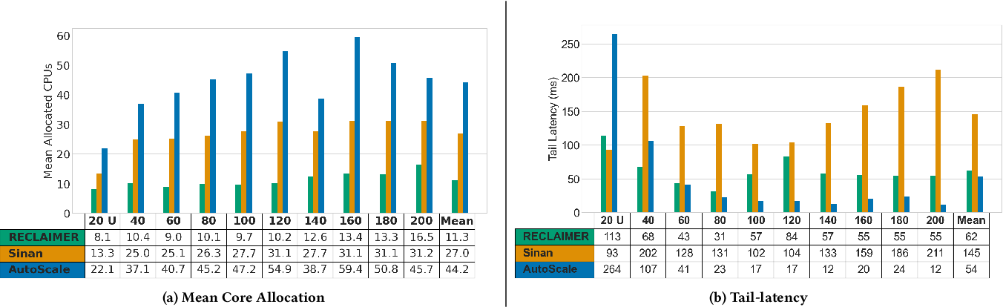

Slide 12
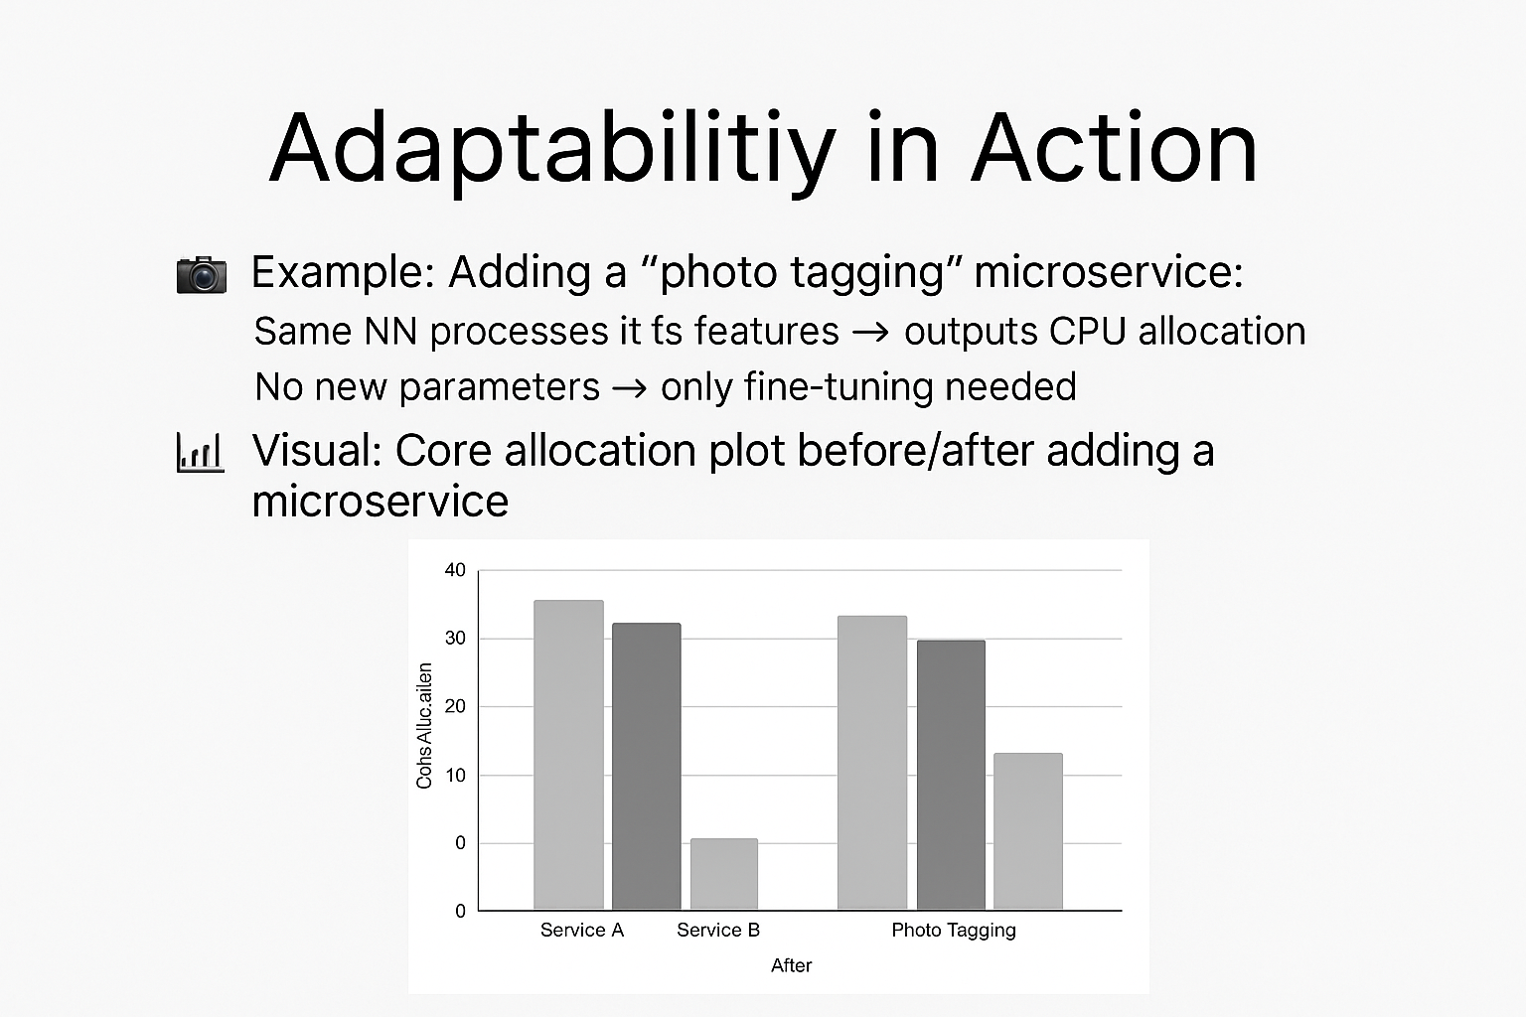
Adaptability in Action
Example: Adding a "Photo Tagging" Microservice
The existing neural network (NN) handles this new service without architectural changes.
Inputs from the photo tagging service are processed just like any other microservice.
Output: updated CPU allocation reflecting the new service's demands.
No New Parameters Required
The NN generalizes across services; only fine-tuning is needed.
Efficient adaptation keeps overhead minimal.
Visual Insight
Include a core/CPU allocation plot:
Before: allocation across existing microservices.
After: updated allocation including the photo tagging microservice.

Slide 13
Training Pipeline
Phase 1: Warm-Up
Goal: Initial data collection.
Method:
Use Autoscale policy.
Add uniform noise (±5%) to actions.
Purpose: Explore action space safely and broadly.
Phase 2: Classifier-Guided Exploration
Goal: Safer and more informed exploration.
Method:
Evaluate adjustments of ±1%, ±5%, ±10%.
Choose action with ≥80% QoS probability (based on classifier).
Purpose: Prioritize actions likely to meet QoS constraints.
Phase 3: Online SAC (Soft Actor-Critic)
Goal: Train robust control policy.
Method:
Use replay buffer with collected transitions.
Train over 260K timesteps (~3 days).
Purpose: Fine-tune agent for optimal, real-time scaling.

Slide 14
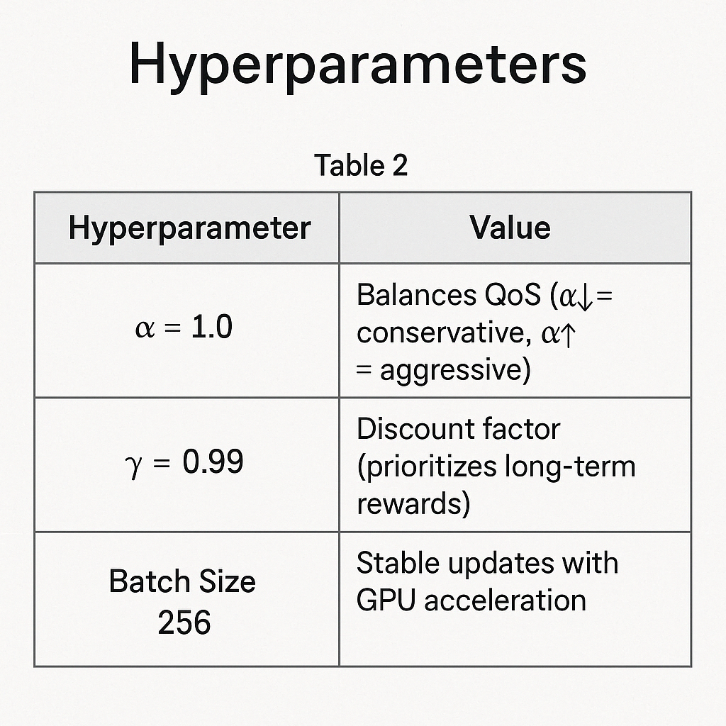
Hyper-Parameters
α = 1.0
Controls exploration-exploitation balance.
Lower α → more conservative actions (focus on QoS).
Higher α → more aggressive actions (favor performance).
γ = 0.99
Discount factor for reward calculation.
Emphasizes long-term gains over short-term outcomes.
Batch Size = 256
Ensures stable gradient updates.
Optimized for GPU efficiency during training.

Slide 15
Pretraining & Fine-tuning for Transfer Learning
🏨 Pretraining Domain:
Dataset: Hotel Reservation System
Features: 15 microservices (e.g., payment, booking, notifications)
Purpose: Teach the model general patterns of resource allocation
📱 Fine-tuning Domain:
Dataset: Social Media Platform
Features: 28 microservices (e.g., posting, photo tagging, messaging)
Objective: Adapt pretrained model to a more dynamic and complex environment
⚡ Performance Boost:
2× faster convergence compared to training from scratch
Pretrained weights help the model adapt quickly with fewer training steps
Demonstrates effective knowledge transfer

Slide 16
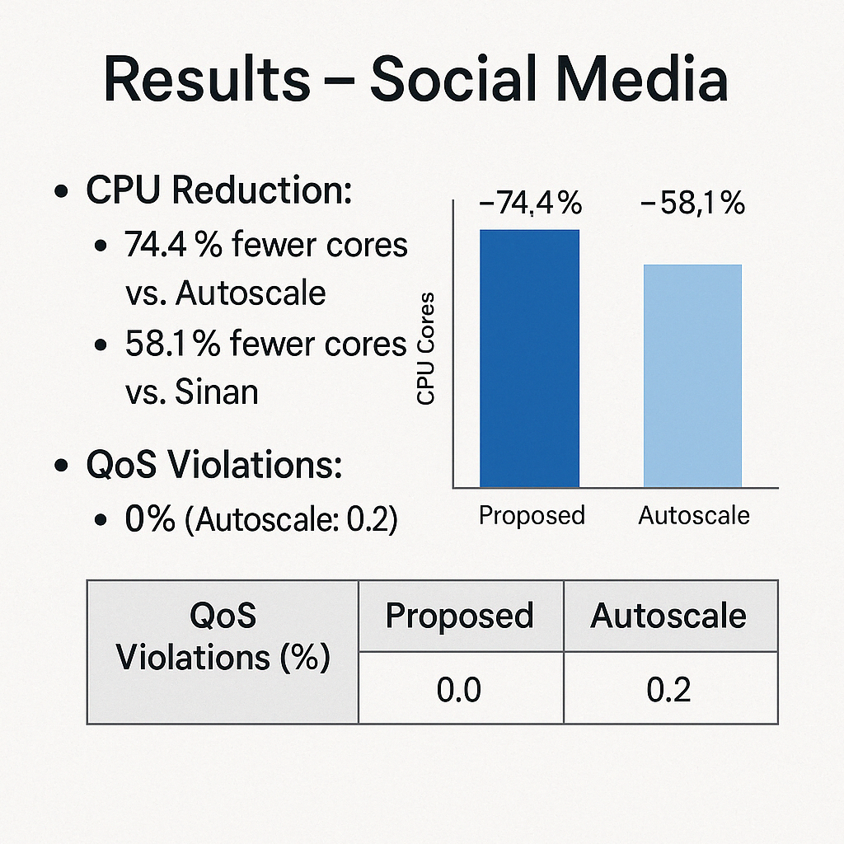
Results-Social Media
Section 1: CPU Efficiency
Significant Core Reduction:
Achieved 74.4% fewer CPU cores used compared to Autoscale baseline.
58.1% fewer cores used compared to Sinan (state-of-the-art prior method).
Implication:
Demonstrates high resource efficiency without compromising on service quality.
Leads to lower operational costs and better energy efficiency in deployment.
Section 2: Quality of Service (QoS)
QoS Violations:
Proposed Method: 0% violations
Autoscale: 0.2% violations
Implication:
Maintains strict performance guarantees under dynamic load.
Ensures user satisfaction and system reliability.

Slide 17
Why Reclaimer Wins
Proactive Resource Management
Reclaimer anticipates demand spikes to prevent QoS violations.
In contrast, Autoscale reacts only after violations occur.
Generalizable Across Applications
No manual tuning or domain-specific customization required.
Unlike Sinan, which often needs per-application tuning to work effectively.
Significant Cost Savings
Uses fewer CPU cores, directly translating to lower cloud bills.
Achieves efficiency without compromising service reliability.

Slide 18
Broader Impact
For Cloud Providers (e.g., AWS, GCP, Azure):
Massive Efficiency Gains:
Reclaimer minimizes CPU over-provisioning across thousands of services.
Potential Billions in Savings:
Even small % reductions in resource usage at hyperscale = $B/year saved.
Sustainability Boost:
Lower energy usage → reduced carbon footprint and greener operations.
For Developers / DevOps Teams:
Plug-and-Play Integration:
Designed to work with existing microservice architectures (e.g., Kubernetes).
No Expert Tuning Needed:
Automatic adaptation across services without per-app customization.
Improved SLAs Without Complexity:
Better QoS adherence → fewer incidents, happier users.

Slide 19
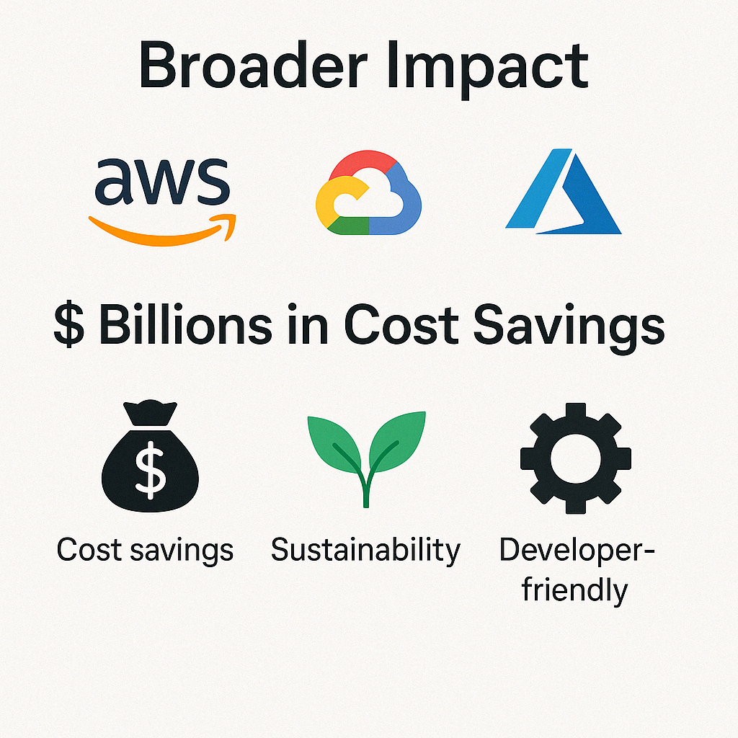

Slide 20
Simulated Implementation – Why & How
Why I Built This
Visually demonstrate the challenge in dynamic resource allocation.
Complement Reclaimer theory with a simple simulation.
Show how QoS violations occur when resources aren't allocated smartly.
What I Implemented
Simulated 3 microservices with fluctuating workloads.
CPU allocation: 1 unit per 10 workload units.
Calculated latency and flagged QoS violations (>100ms).
Plotted real-time CPU and latency using Python + Matplotlib.

Slide 21
Key Observations & Reclaimer Connection
What the Graphs Showed
Latency spikes when workload increases but CPU isn’t scaled enough.
Simple policies lead to QoS violations and inefficiency.
Highlights the limitations of reactive/static allocation.
Why Reclaimer is Better
Learns workload trends and adapts proactively.
Prevents violations before they happen.
Optimizes core usage while maintaining service reliability.
My simulation reinforces the need for intelligent RL-based methods like Reclaimer.

Slide 22
Thank You

